Slide 1


Installing Git in Mac

Slide 2
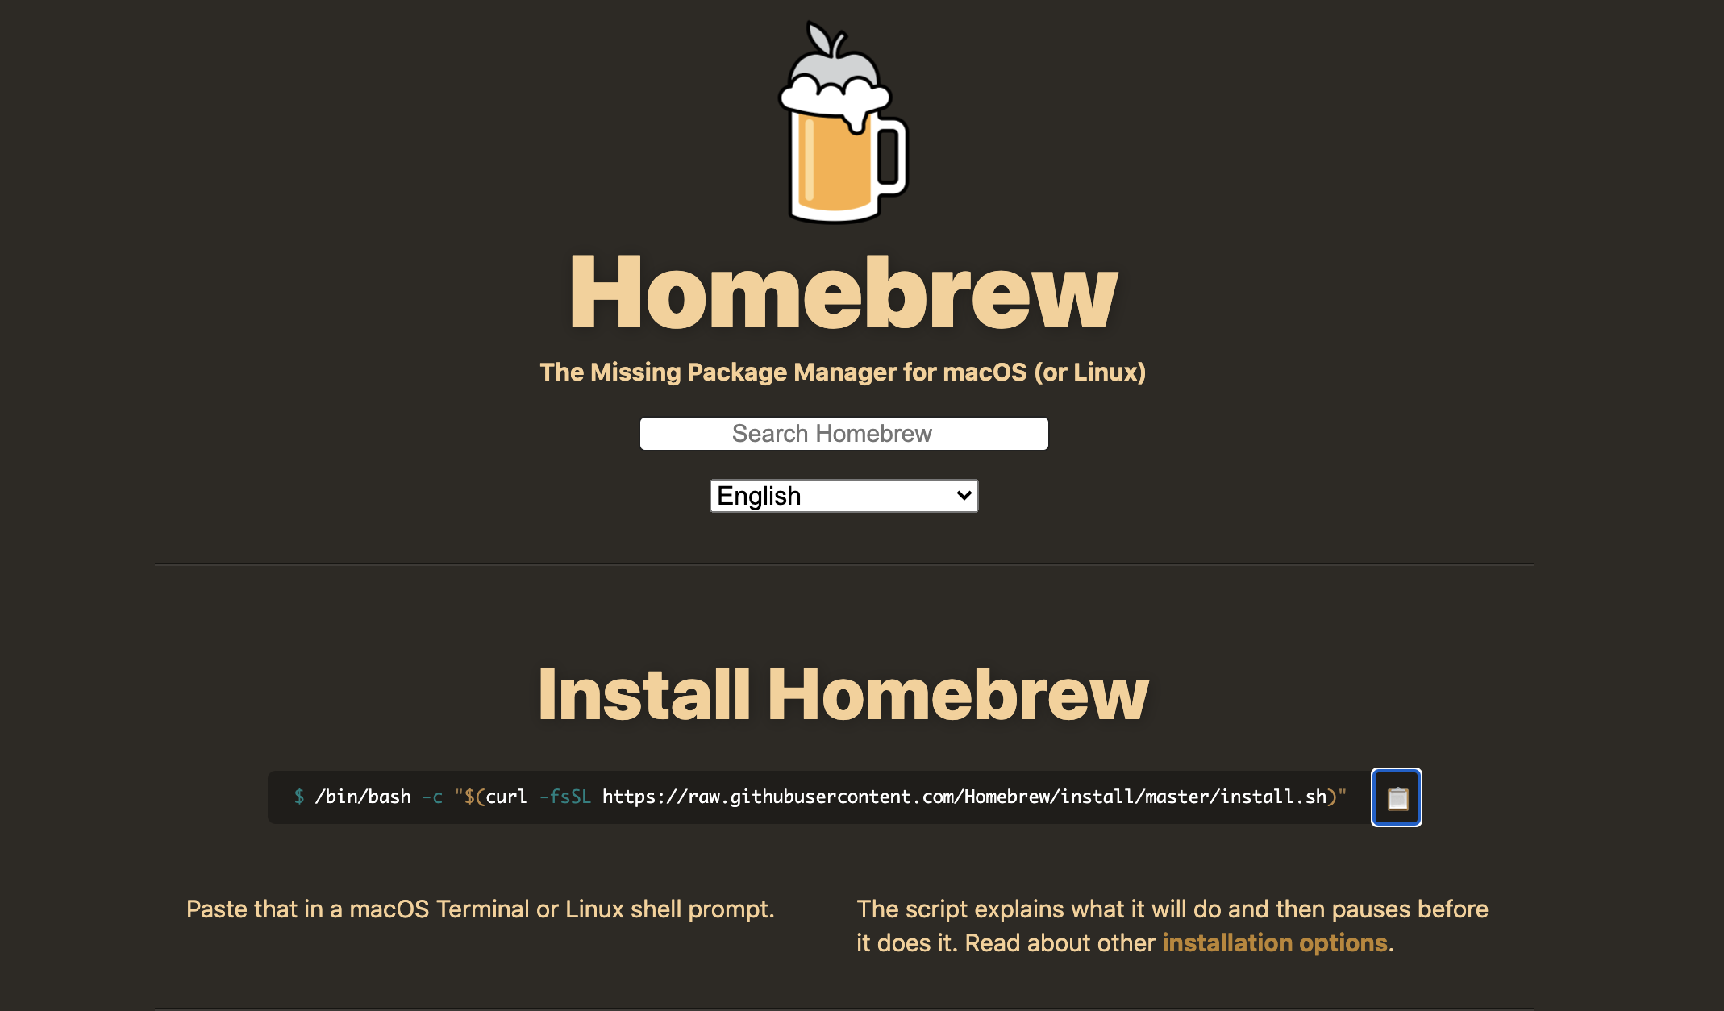

Installation
Go to www.brew.sh and copy the bash command.

Slide 3
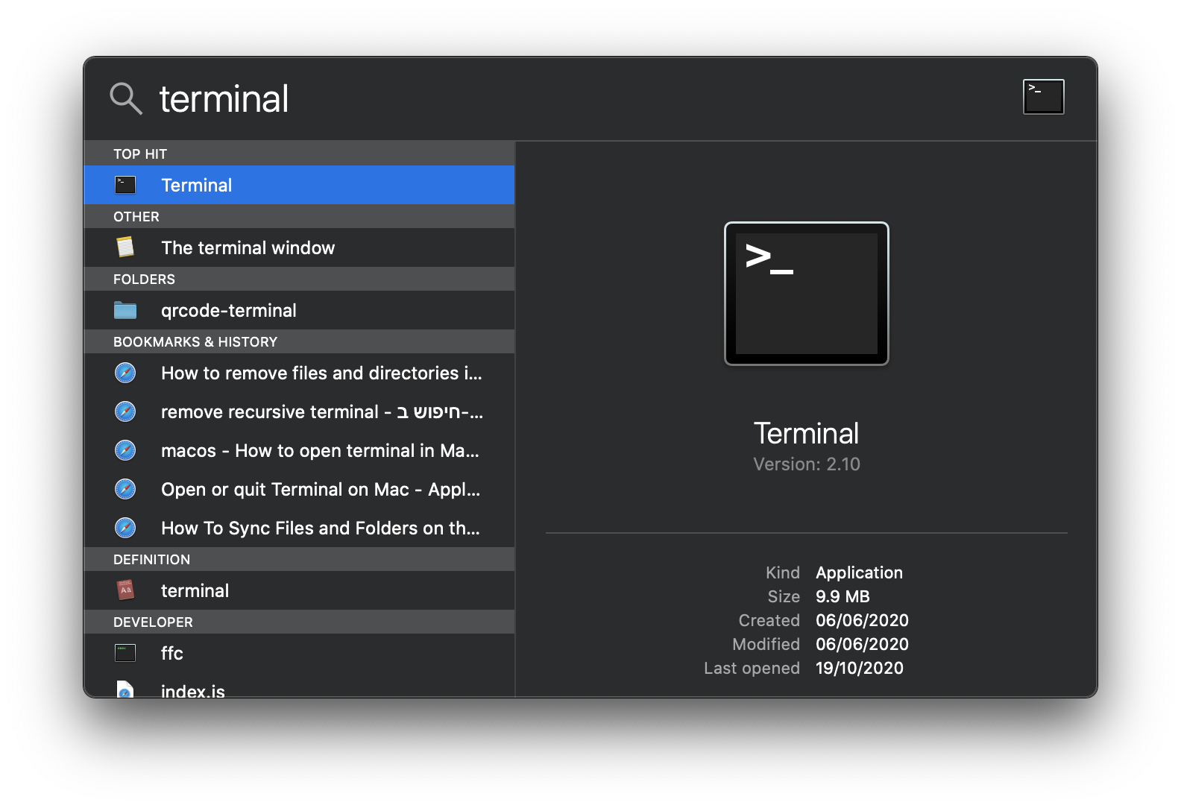
Installation
T
Open a terminal window

Slide 4
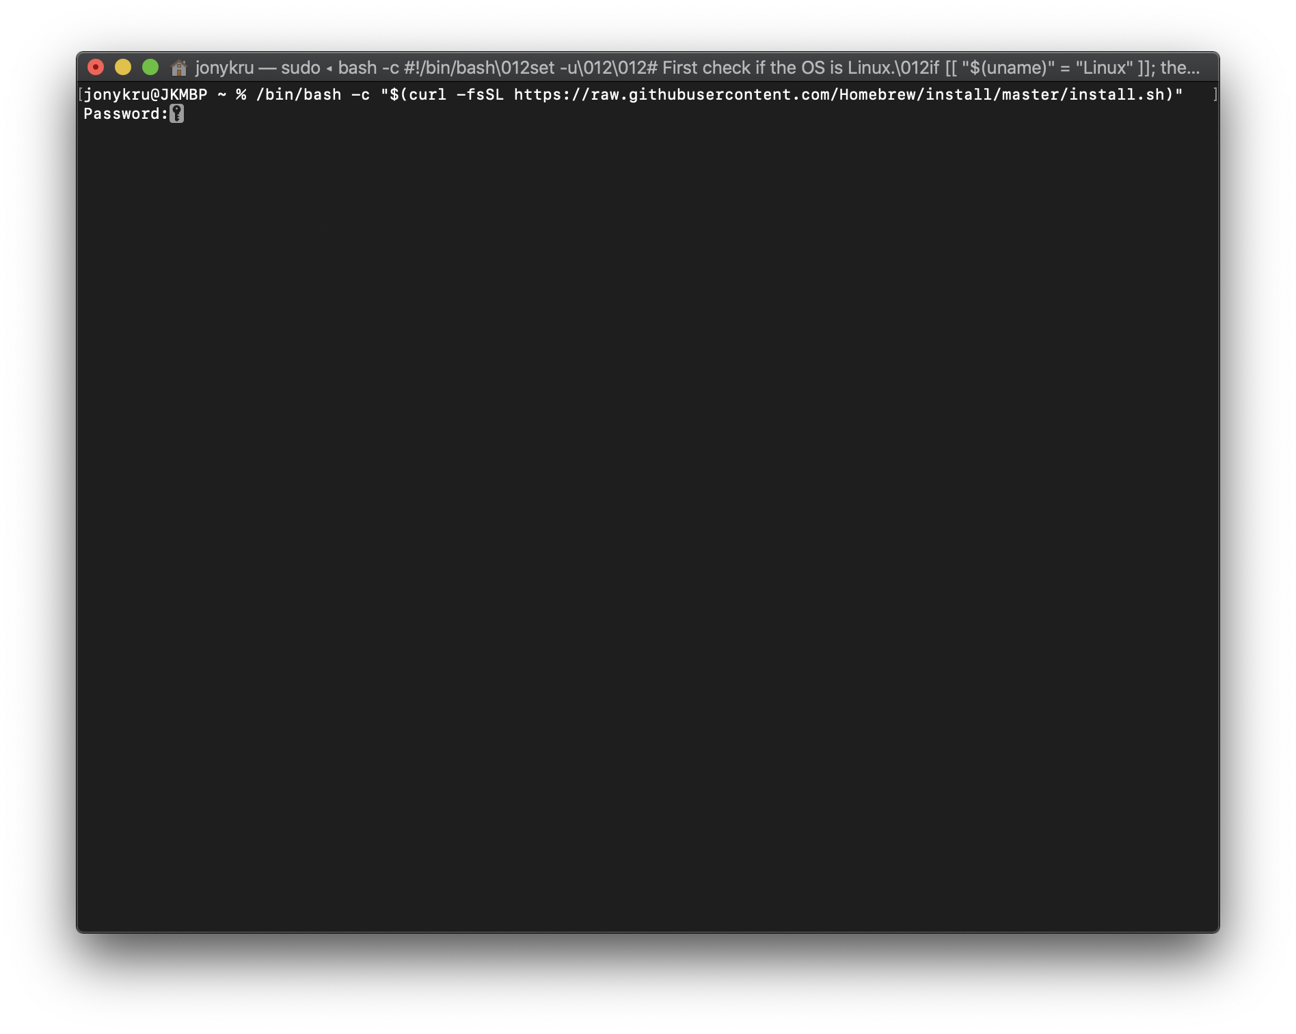
Installation
Paste the command from the brew website and run it.
It might ask for your password.

Slide 5
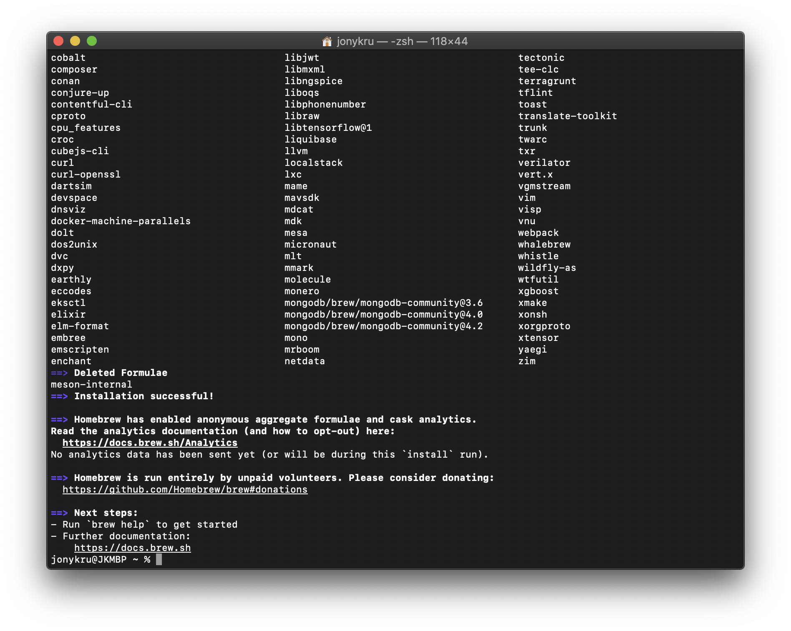
Installation
Wait for it to finish.
Might take several minutes

Slide 6
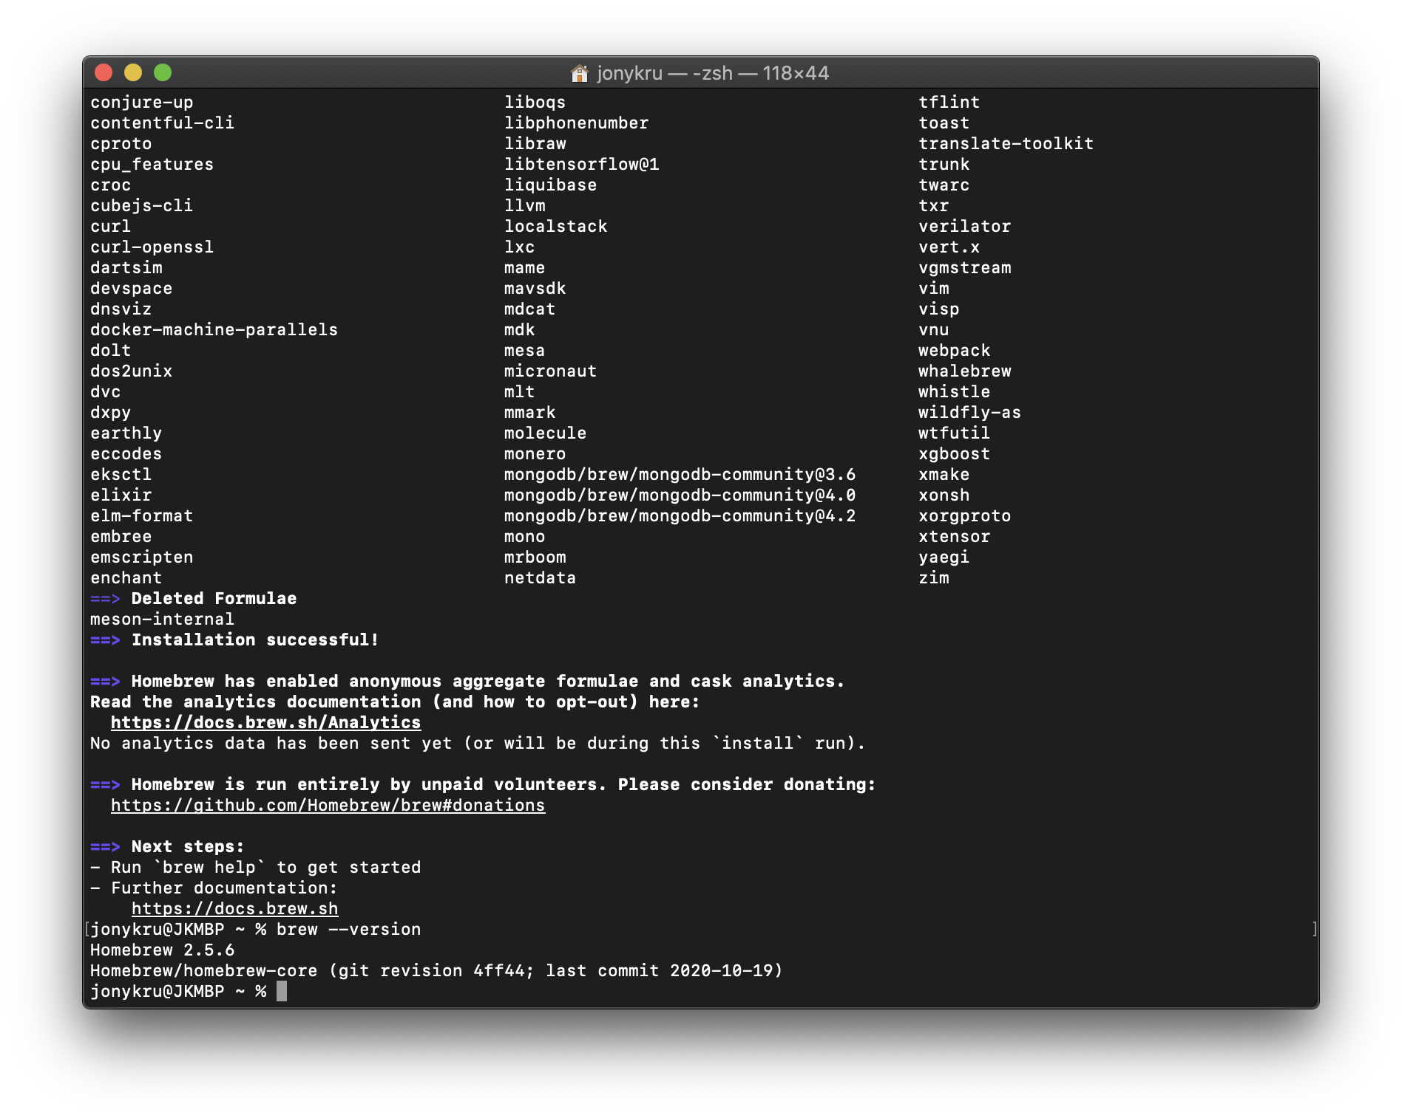
Installation
T
Check that brew got installed by checking the version:
brew --version
Might happen that you will run into some Xcode error. In that case, research for an online solution.

Slide 7
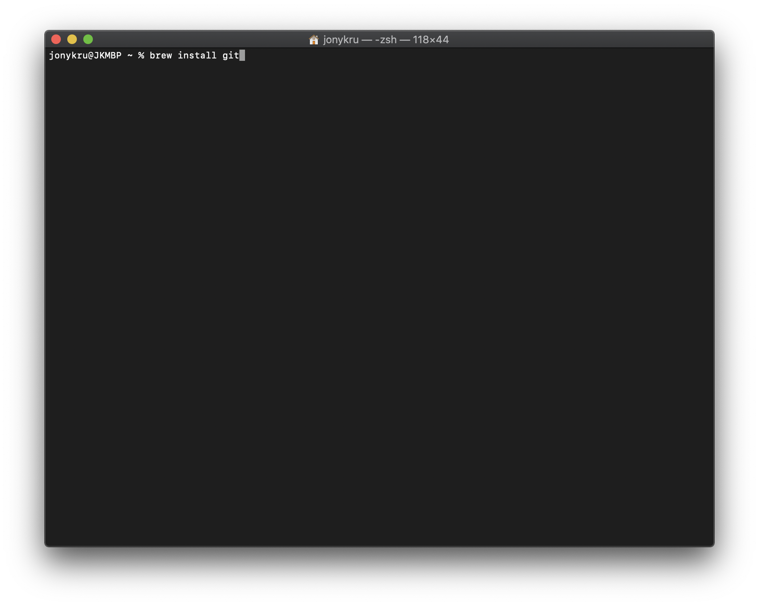
Installation
T
Install git by running:
brew install git

Slide 8
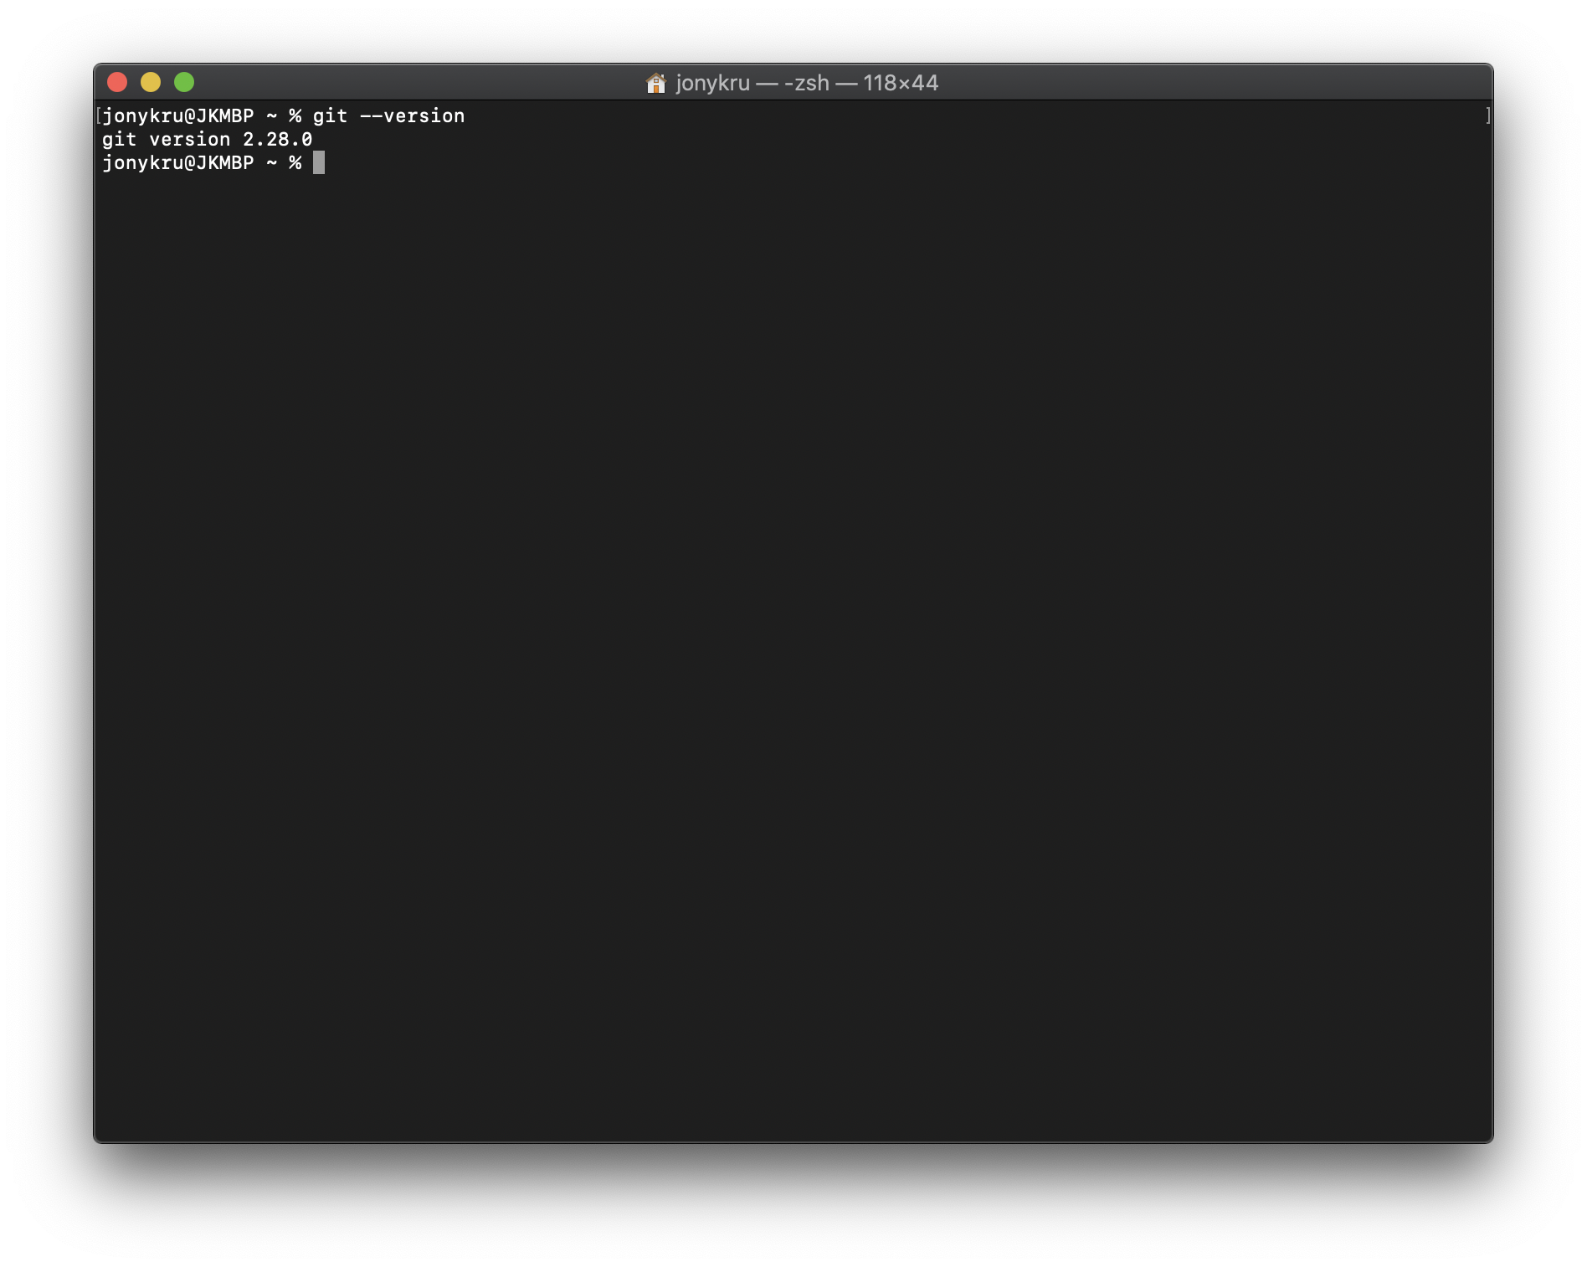
Installation
T
Check that Git was installed
git --version

Slide 9
Installation
T
Check that Git was installed
git --version

Slide 10
Troubleshooting on Homebrew
T
If it gets stuck downloading the package:
https://stackoverflow.com/questions/41030429/brew-upgrade-hangs-on-el-capitan
An alternative solution:
https://discourse.brew.sh/t/install-hanging-on-macos-catalina/6649

